Slide 1
Initial Operational Response (IOR)
to Incidents Suspected to Involve Hazardous Substances
or CBRN Materials.
January 2023
Notes:
2023 Initial Operational Response (IOR) to Incidents Suspected to Involve Hazardous Substances or CBRN Materials.
This lesson has been provided following a review of the initial IOR Guidance published in 2015. The IOR guidance has been reviewed as analysis of data has shown that potential CBRN incidents are not recognised at an early stage and that by utilising this for a broader definition of incidents such as criminal, accidental and terrorist incidents it will maximise safety to Responders and the General Public.

Slide 2
Aim
To raise delegates knowledge, understanding and awareness
of the revised IOR Guidance.
Notes:
Lesson Aim:
To raise delegates knowledge, understanding and awareness of the revised IOR Guidance.

Slide 3
Lesson Objectives
By the end of the session delegates will be able to:
Explain the primary objectives of the IOR.
State the principles for an effective multi-agency response.
Describe the key elements of M/ETHANE and the Joint Decision Model.
Explain the initial actions to take following a hazardous substance incident (RAR).
Describe the key elements of Public and Responder Safety.
Demonstrate the REMOVE principles.
Explain the considerations for vulnerable people.
Notes:
By the end of the session delegates will be able to:
Explain the primary objectives of the IOR.
State the principles for an effective multi-agency response.
Describe the key elements of METHANE and the Joint Decision Model.
Explain the initial actions to take following a hazardous substance incident (RAR).
Describe the key elements of Public and Responder Safety.
Demonstrate the REMOVE principles.
Explain the considerations for vulnerable people.

Slide 4
Stages of Response
IOR
Initial Operational Response
Commences when the first report of an incident is received by the Emergency Services and provides the opportunity to immediately provide life-saving advice whist determining a coordinated, controlled and consistent response.
Specialist Operational Response
Different specialist resources will arrive to the incident at different times. Therefore, the transition from IOR to SOR may take place in an undetermined sequence.
SOR
Notes:
Transition Phase IOR to SOR
Control room receive information suggesting a possible hazardous substance incident.
Control room consult their local Op Halcyon CBRN response plans & use standard pathways to FRS Hazardous Materials Advisors, CBRN Tac Ads, FRS and Ambulance NILOs & subject matter experts.
This will allow them timely access to specialist advice, but also prioritise specialist assets that need to be deployed to the scene.
Declaration of a major is not service specific. Think of the 3 musketeers – one for all and all for one – This enables all responding agencies to assess the wider impact of the incident whilst triggering mobilisation of regional & national resources where necessary.
Dependant on the situation, a transition phase from IOR to SOR may not always be necessary
Should a transition to SOR be required it is vital that it is instigated at the earliest opportunity whilst not being detrimental to the IOR focus of reducing preventable deaths. The transition to SOR, MUST NOT impede on any life saving activity.
A JDM review will establish which elements of SOR should be deployed, enabling the emergency services to work together.
The response should be proportionate to the threat, flexible and interoperable.
Specialist Operational Response (SOR)
SOR resources are personnel, trained to wear and carry out specialist tasking within the warm & hot zone wearing a higher level of PPE and resolve the incident through other emergency services and partner agencies such as DSTL, AWE, TRF.
If SOR resources are deemed necessary, the arrival, the location, the deployment and the briefing & de-briefing processes need to be managed efficiently and effectively due to the logistical complications involved.
Consideration will need to be given to Traffic Management plan, RVP, Strategic holding areas, Scene management and forensic plans and other issues associated with the deployment or standing up of specialist assets.

Slide 5
The Primary Objectives of the IOR are to:
Maximise the safety of the public and save lives.
Minimise the operational risk to responders.
Ensure an effective transition to the Specialist Operational Response (SOR)
The first 15 minutes are the most critical for achieving life-saving activity.
Notes:
Primary objectives of IOR
Maximise the safety of the public & reduce preventable deaths.
Minimise the operational risks to first responders.
Ensure an effective transition to the Specialist Operational Response
IOR is focused on the immediate advice that the Emergency Services can provide to the public when the first report is received by call handlers.
The call handlers are instrumental in the early identification of a potentially hazardous substance incident and implementing IOR. This advice can be passed to the public enabling them to help themselves. Immediate deployment of suitable resources is critical to ensure life-saving activity and provide a proportionate response.
Maximise the safety of the public & save saveable life.
In the event of an incident whereby people have been exposed to a hazardous substance, the speed of the response is critical to saving lives. By the process of communicating the Remove principles either at the scene or remotely, ideally within the first 15 minutes, the vast majority of skin contaminants can be removed & further injury or death avoided.
Minimise the operational risks to first responders.
First responders must ensure their own safety by carrying out ongoing hazard assessments and are trained and equipped to recognise hazardous substance incidents. Responder safety can be maximised by effective provision of training and equipment from CBRN tactical and scientific advisors. to be shared in line with JESIP principles using the METHANE multi-agency reporting tool which enables a safer IOR.
Ensure an effective transition to the Specialist Operational Response
Prompt information sharing between Responders and call – handlers as well as sharing with other agencies are in line with the JESIP Joint Doctrine. This should follow a general pattern of:
Situation (Working out what’s going on)
Direction (Establishing what you need to achieve)
Action (Deciding what to do about it)
It is reality that one emergency service will arrive ahead of the others in response to an incident. THIS MUST NOT delay commencing life-saving activity.

Slide 6
JESIP
Notes:
Trainer to discuss the importance of the JESIP Joint Doctrine. This will allow joint emergency services to work together with the aim of saving lives & reducing harm.
This is underpinned by the Civil Contingencies Act 2004 (CCA) which puts a duty on Responders to prevent, plan, prepare, test, respond and recover to or from an emergency. The Emergency Preparedness guidance puts two further duties on Responders to co-ordinate and share information.
The Joint Doctrine:
Ensures an effective response and achieves the JESIP aim of ‘working together, saving lives, reducing harm’
Used during all phases of an incident, whether spontaneous or pre-planned and regardless of scale.
Support the development of a multi-agency response and provide structure during the response to all incidents.
Principles can also be applied during the recovery phase.

Slide 7
JESIP Principles
CO-LOCATE
Co-locate with other responders as soon as practicably possible at a single, safe and easy identified location.
Communicate using language which is clear, and free from technical jargon and abbreviations
COMMUNICATE
CO-ORDINATE
Co-ordinate by agreeing the lead organisation. Identify priorities, resources, capabilities and limitations for an effective response, including the timing of further meetings.
JOINT UNDERSTANDING RISK
Jointly understand risk by sharing information about the likelihood and potential impact of threats and hazards, to agree appropriate control measures.
SHARED SITUATIONAL AWARENESS
Establish shared situational awareness by using M/ETHANE and the Joint Decision Model.
Notes:
Principles for joint working - JESIP Website
The JESIP Joint Doctrine – The Interoperability Framework, sets out the key models and principles for an effective, multi-agency response, supporting the overarching aim of working together, saving lives and preventing harm. This approach is key to the effectiveness of IOR and therefore the principles for joint working should be adopted.

Slide 8
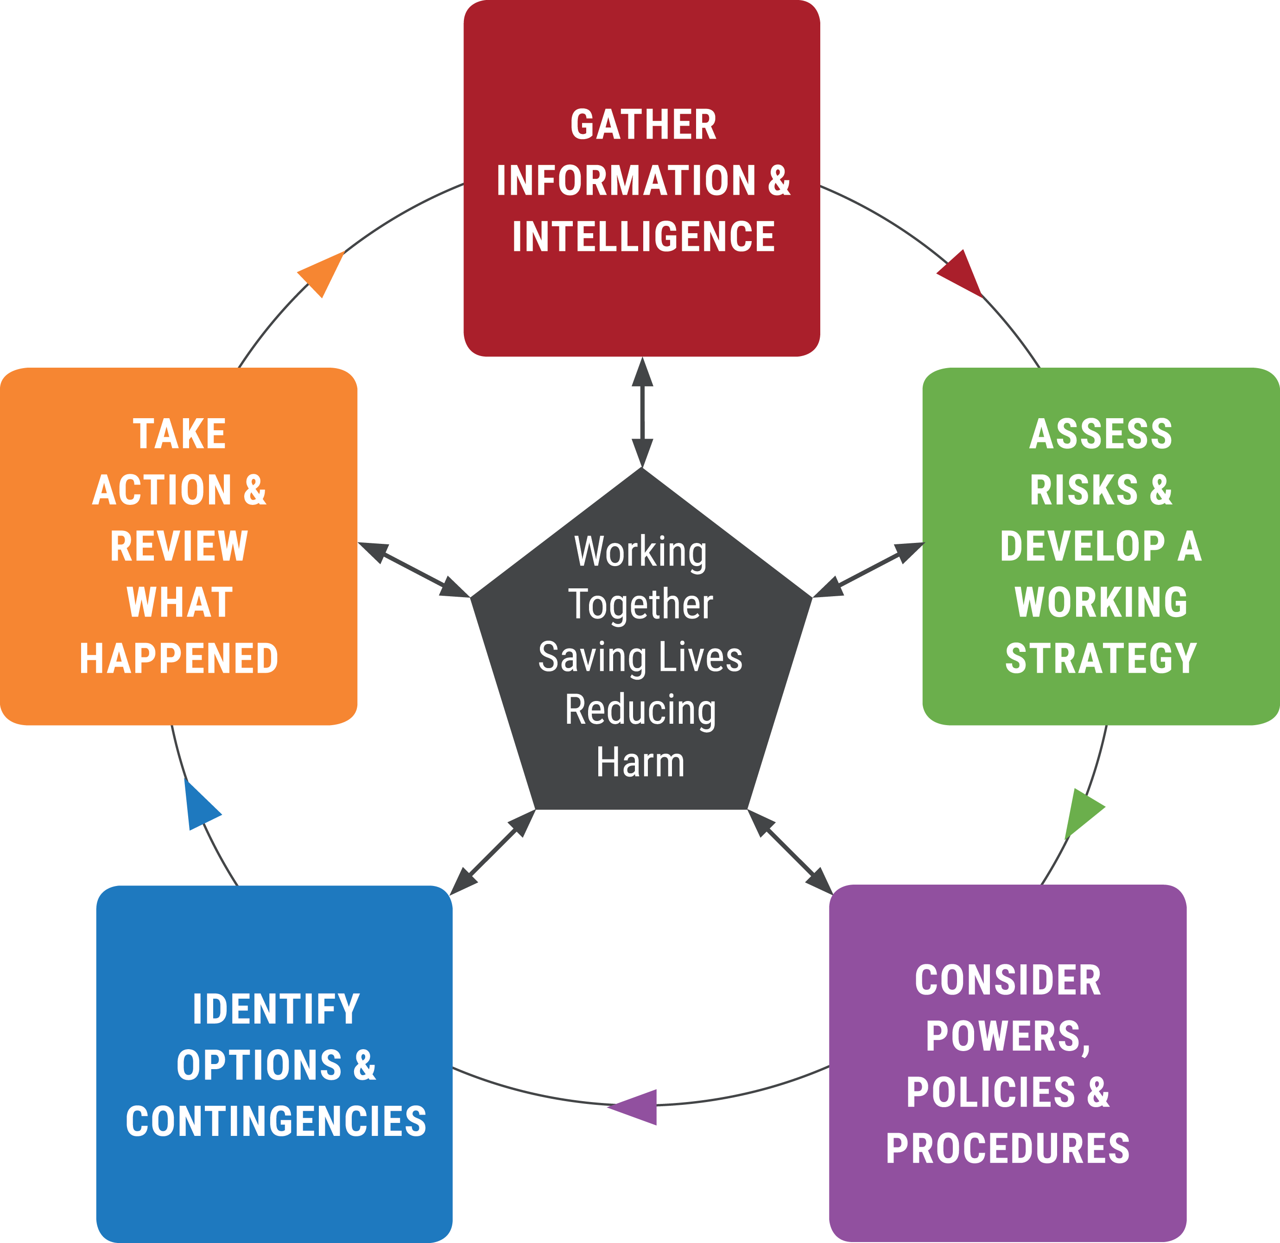
Joint Decision Model
Save life and prevent further harm.
Minimise the spread of contamination.
Employ effective communication.
Maintain public confidence.
Notes:
The Joint Decision Model (JDM) - JESIP Website
The JDM assists in the development of a jointly agreed working strategy and ensure all responders understand the agreed course of action, including what is happening currently, what is going to happen, when, and by whom.
In the early stages of IOR it is unlikely there will be opportunity to develop a bespoke working strategy. Consequently, this generic strategy can be adopted but should be reviewed at the earliest opportunity:
Save life and prevent further harm
Minimise the spread of contamination
Employ effective communication
Maintain public confidence
Whilst the public are the focus, every effort should be made to maximise responder safety in the form of training, equipment and operational support from CBRN tactical and scientific advisors.
Arrangements for joint working enable incident management to follow a general pattern of:
Working out what is going on (situation);
Establishing what you need to achieve (direction);
Deciding what to do about it (action)
It is an operational reality that one emergency service will arrive ahead of the others in response to an incident. This MUST NOT delay commencing life-saving activity. This document details what can be done by first responders from any agency despite their own limitations in CBRN specialist capability to respond.
When multiple agencies are on scene, a joint understanding of risk based on agency-specific dynamic risk and hazard assessments will further enhance decision making. This promotes a co-ordinated and effective multi-agency response which maximises safety, meets the working strategy and aims to deliver a prompt resolution or an efficient transition to SOR.

Slide 9
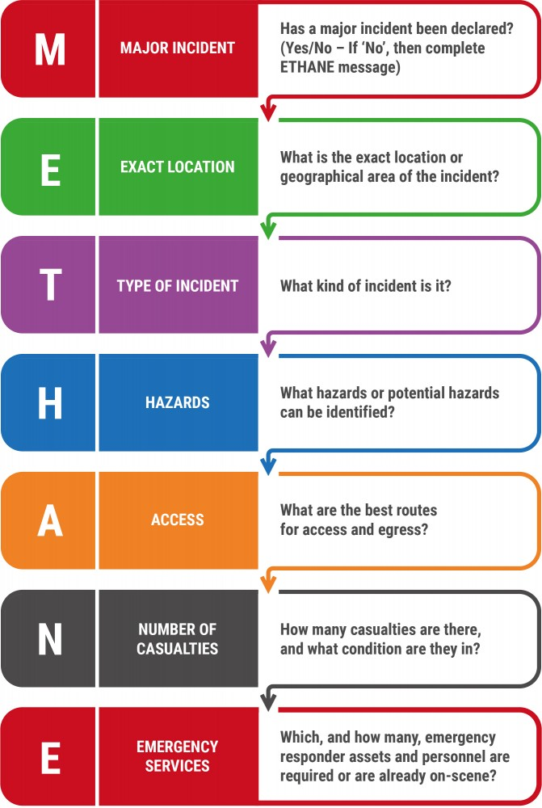
Situation Reporting
CO-LOCATE
COMMUNICATE
CO-ORDINATE
JOINT UNDERSTANDING RISK
SHARED SITUATIONAL AWARENESS
Notes:
M/ETHANE - JESIP Website
Using the M/ETHANE system of reporting as the recognised common model for passing information between services and control rooms will allow for Joint Understanding of Risk (JUR) & Shared situational Awareness (SSA)
This needs to be updated periodically or as an incident develops.
Trainer to talk through the M/ETHANE reporting model
M – Major Incident – Has a Major incident or standby been declared? Yes/No – if no, then complete ETHANE message. Include the date and time of any declaration.
E – Exact Location – What is the exact location or geographical area of the incident? Be as precise as possible using a system that will be understood by all responders
T – Type of Incident – What kind of incident is it? For example, CBRN attack, MTA, Flooding, Fire, Utility failure, Disease outbreak
H – Hazards - What hazards or potential hazards can be identified? Consider the likelihood of a hazard and the potential severity of any impact
A – Access – What are the best routes for access and egress? Include information on inaccessible routes and RVP’s. Remember that services need to be able to leave the scene as well as access it, especially in the case of Ambulances with Casualties.
N – Number of Casualties – How many casualties are there, and what condition are they in? Use an agreed classification system such as ‘P1’, ‘P2’, ‘P3’ and ‘dead’ (Injuries incompatible with life).
E- Emergency Services – Which, and how many, emergency responder assets and personnel are required or are already on scene? Consider whether the assets of wider emergency responders, such as local authorities or the voluntary sector, may be required.

Slide 10
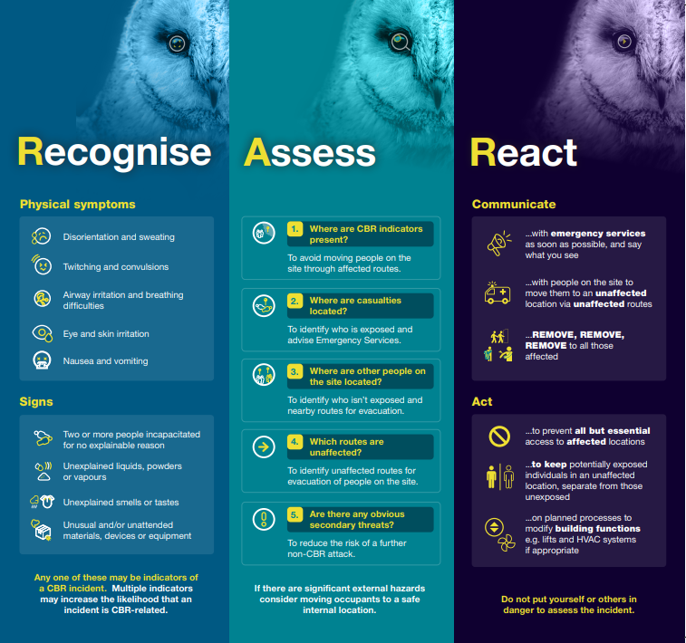
Effective Response To An Incident
Notes:
Assessing an Incident (RAR)
Recognise
Assess
React
Recognise, Assess, React (RAR) for Chemical, Biological and Radiological (CBR) Incidents | CPNI
The CPNI (Centre for the Protection of National Infrastructure) has released the RAR threat recognition tool for Security Control Room Staff to respond to a CBRN incident. This has been incorporated into the IOR campaign.

Slide 11
R
ecognise
What
Where
Why
Who
When
is happening?
is it?
is it suspicious?
found it
was it found?
Visual Indicators
VS
Physical symptoms
Notes:
Recognise
Recognise the indicators of a hazardous substance incident.
Information gathering from the initial call by call handlers will form part of the initial recognition of the type of incident first responders will encounter key questions that will inform the response include the 5Ws:
What is happening? What indicators suggest hazardous substances?
Where is it? Are there factors which make this location more attractive as a target or more vulnerable to an attack e.g. A significant event, iconic location, critical national infrastructure or a Publicly Accessible Location (PAL)
Why is it suspicious? Has this been found as part of a venue search and why was this search taking place?
Who found it? Has anyone else seen it? If this is a member of the public have their details been obtained in order that further information can be obtained if required.
When was it found? What time was it found?
Visual Indicators
Was the offender(s) seen to carry out a deliberate act, where are they now, which direction did they leave in.
Any unusual / out of context liquids, powders, vapours, smells or tastes.
Any unusual & or unattended materials, devices or equipment.
What are the physical symptoms? (disorientation, sweating, irritation, twitching/convulsions, nausea/vomiting, breathing difficulties).
Physical symptoms…
Casualties can be an indicator of a hazardous substance incident & should be considered in conjunction with other indicators & signs or symptoms. These may include, but not limited to the physical symptoms of:
Disorientation & sweating.
Twitching & convulsions
Airway irritation & breathing difficulties.
Eye & skin irritation.
Nausea & vomiting.

Slide 12
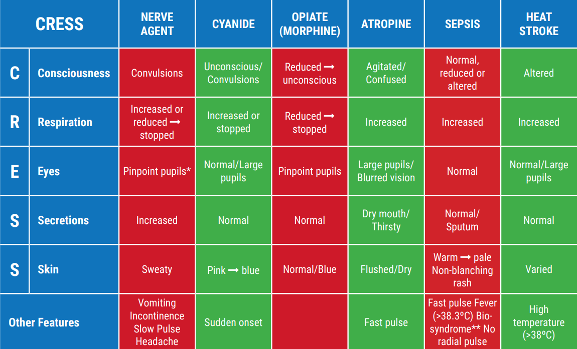
A
ssess – Casualty Assessment
Notes:
Casualty assessment
Symptoms of exposure to some hazardous substances, such as those used in a biological or radiological attack, may not be present in the first minutes, hours or days of release occurring. Chemical releases are often, but not always accompanied by a more rapid onset of symptoms.
Without sufficient medical training, it can be difficult to recognise the cause of specific symptoms. Using the CRESS tool to report back key information could help health services identify the type and nature of the hazardous substance incident.
First responders, without putting themselves at undue risk, may have an opportunity to attain information form casualties which supports a CRESS assessment.
Trainer to discuss the CRESS tool. CRESS is an assessment tool based on 5 parameters to systematically assess an individual in order to identify an associated Toxidrome. Put in simple terms, it enables the user to have a good look at an individual and assess if there is anything odd going on.
Cress Tool
C - Consciousness – What is the level of consciousness? Are they drowsy?, On edge?, Completely unresponsive? Fitting? Confused? Behaving strangely?
R- Respiration - What is the respiratory rate – is it increased or decreased? How many times a minute are they breathing? Are they struggling to breath or having to exert themselves to breath?
E – Eyes – Examination of pupils and their reaction. You will obviously not be compromising your safety to get close enough to certain subjects to assess their pupillary response. However, You may notice constricted pinpoint pupils or dilated pupils from a reasonable distance away.
S – Secretions – Are there increased or decreased secretions? Secretions way be in the form of saliva, tears, sweat, bile or mucus.
Conversely the subject may have decreased secretions such as a dry mouth or dry skin.
S – Skin – Examine for colour and other signs such as sweating.
Does the subject(s) skin appear a different colour from normal, it may be pink, blue, flushed, dry or pale.
Other features that should be noted are: Have you noticed anything else unusual about the subject? Fever? Incontinence? Headache? Was the onset of symptoms sudden or delayed? Are they vomiting? Is there more than one person suffering symptoms?

Slide 13
A
ssess – Substance Assessment
C
olour
B
ehaviour
O
odur
A
ppearance
L
ikeness
D
issemination
D
eliberate
S
ymptoms
Notes:
Substance Assessment
Information from initial reports regarding the characteristics of any substance(s) causing concern will help to categorise and potentially subsequently identify it. The BAD COLDS tool may be used to support this process even prior to the deployment of specialist resources.
Trainer to note: This has previously been referred to as BAD COLDS ACT and is still reflected as such within the IOR document. The ACT elements (Action to take following identification of a suspicious substance) will now form part of the REACT stage of RAR.
Assess
BAD COLDS
B - Behaviour – What did the substance behave like? Is this off-gassing from a container? Is the vapour heavier than air and sinking to the ground or lighter than air and rising? Did it fall to the floor in a soggy lump or Is the substance remaining in the same place or is it diluting or travelling with the wind?
A - Appearance – Is it a powder, liquid, gel or a solid? How much is there etc?
D – Dissemination – Was it thrown, sprayed, mechanically spread or delivered.
C – Colour – is it pure white, off white, yellow or multi-coloured?
O – Odour – Did it smell? Under no circumstances should responders deliberately smell a substance as a means of determining whether it has an odour or not.
L – Likeness – Does it look like something you know?
D – Deliberate - Did the release of the substance appear deliberate or accidental?
S – Symptoms – Is anyone exhibiting any symptoms?
Trainer to NOTE;
Under no circumstances should frontline responders be further exposed to a known/suspected hazardous substances in order to obtain the above information. It may not be possible to carry out a full assessment during IOR.

Slide 14
R
eact
Safety Advice to Responders
Whilst life saving actions for the Public is the focus there needs to be safety priorities for Responders
Priority communication to Responders:
DO NOT take risks without appropriate training or PPE
If there are incapacitated casualties for no explainable reason they MUST NOT PROCEED any closer.
Approach incident ideally from an uphill/upwind direction
Use caution, keep a safe distance to avoid exposure to themselves
Consider using Public Address systems to assist in calling people towards them.
Take steps to prevent cross-contamination.
Notes:
Safety advice to Responders
Whilst life saving actions for the Public is the focus there needs to be safety priorities for Responders
Priority communication to Responders:
DO NOT take risks without appropriate training or PPE
Approach incident ideally from an uphill/upwind direction
Use caution, keep a safe distance to avoid exposure to themselves
Consider using Public Address systems to assist in calling people towards them
Take steps to prevent cross-contamination
Utilise a M/ETHANE message to pass as much information to Control Rooms as possible without delay
This message needs to be passed to Responders without delay. Life saving activity cannot take place if Responders are put at unnecessary risk. Staff should be trained and equipped to carry out life saving activity such as rescue but unprotected Responders can still assist without committing themselves into a contaminated area. Appropriate messages can be passed following REMOVE principles.
REMEMBER: If responders observe incapacitated casualties for no explainable reason – they must consider whether to proceed any closer to avoid becoming a further casualty themselves. It may not be possible to carry out a full CRESS assessment during IOR. Unprotected responders should avoid mouth to mouth resuscitation and use hands-only chest compressions to reduce the risk of cross-contamination to responders, whilst being aware that exhaled air may still pose a risk.

Slide 15
R
eact
Safety Advice to the Public
If a person/s are suspected to be in a hazardous area, or could potentially be affected by a hazardous substance, they should be advised in accordance with the REMOVE principles.
Advise casualties that they should:
Avoid eating, drinking, smoking or touching their face and eyes as this can increase the risk of further contamination through ingestion, inhalation and absorption;
Continue to move away upwind and preferably uphill from the release;
Not to leave the area to seek hospital care as by doing so they may be putting themselves or others at risk by exposing them to contaminants which may be on their clothing or skin..
Notes:
React
Safety advice to the public
If a person/s are suspected to be in a hazardous area, or could potentially be affected by a hazardous substance, they should be advised in accordance with the REMOVE principles.
Advise casualties that they should;
Avoid eating, drinking, smoking or touching their face and eyes as this can increase the risk of further contamination through ingestion, inhalation and absorption;
Continue to move away upwind and preferably uphill from the release;
Not to leave the area to seek hospital care as by doing so they may be putting themselves or others at risk by exposing them to contaminants which may be on their clothing or skin. Tell people that medical assistance is coming to them, and they should wait for this to arrive.
Additional considerations for enclosed space settings include but are not limited to:
Consider evacuating/invacuating – Use of a fire alarm system may be beneficial for a quick evacuation.
Consider the route out – remember some gases are heavier that air
Following consultation with emergency service partners consider shutting down air-conditioning systems but only where this action would not delay evacuation or have an adverse effect.

Slide 16
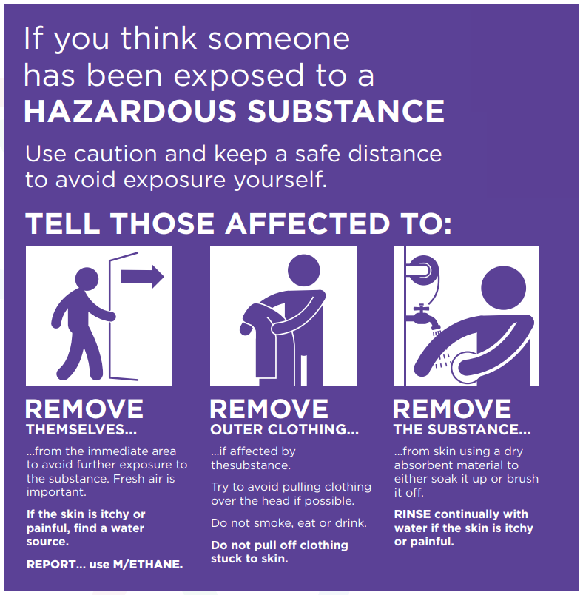
R
eact
Remove Principles
Notes:
Remove Campaign (RRR)
The ‘REMOVE, REMOVE, REMOVE’ principles provides control room staff, front line responders, and those responsible for crowded places, with essential safety and advice for responding to a suspected deliberate or accidental exposure to a hazardous substance (vapour, powder or liquid).
It can be applied by anyone, anywhere and will assist in keeping personnel safe and saving lives. It has been developed in conjunction with Public Health specialist and the three emergency services and is consistent with NHS public information on responding to hazardous substance exposure

Slide 17
R
eact
Remove People From The Hazard
Fundamental to life-saving in the initial stages of an incident
Advise people to move away from area of gross contamination uphill and upwind.
If possible, direct walking casualties to this area immediately.
Should commence within 15 minutes.
Notes:
Remove themselves from the hazard.
Fundamental to life-saving in the initial stages of an incident.
Advise people to move away from area of gross contamination uphill and upwind.
If possible direct walking casualties to this area immediately.
If non ambulant casualties cannot self evacuate themselves they will need to “snatch” rescued. The Fire & Rescue Service (FRS) are the only service trained & equipped to conduct snatch rescues and carry out emergency decontamination for these individuals.
Casualties should be moved to an area upwind & ideally uphill of the incident. Consider the use of cordons to ensure further casualties are avoided.
Should commence with 15 minutes
Communicate to casualties as soon as possible and continue throughout the incident. Accurate and continued dialogue helps to foster trust and confidence. Where possible this should involve simple language taking into account those casualties who cannot understand or are unable to physically do what is expected of them. Evidence from exercising has taught us that the process of gaining compliance from the public becomes increasingly difficult with groups containing more than 10 people. This is a challenge that responders should be acutely aware of at mass casualty events. Responders need to understand and recognise this challenge, by applying the models and principles in this guidance will ensure that aim of working together, saving lives and reducing harm remains at the forefront of everything they do.
Trainer to NOTE;
Removing casualties away from the area or source of contamination should be carried out as a priority. Ambulant casualties should, where possible, be directed to remove themselves. Where casualties cannot self - evacuate appropriate risk assessments should be carried out at scene to inform whether to deploy staff to rescue saveable lives.

Slide 18
R
eact
Remove Outer Clothing
Procedure to be conducted by casualty themselves.
Avoid removing clothing over their head.
Emergency services to facilitate from a distance.
Issue disrobe packs from FRS appliance as a priority and remove all clothing.
If possible consider the welfare and dignity of the casualties.
Notes:
Initial Operational response (IOR)
Remove outer clothing
Procedure to be conducted by casualty themselves
Avoid moving clothing overhead – cut off where this is not possible.
Emergency services to facilitate from a distance.
Issue disrobe packs from FRS appliance as a priority and remove all clothing
If possible consider the welfare and dignity of the casualties.
Removing potentially contaminated clothing is a critical step in the decontamination process. It is highly effective at reducing the effects of exposure to contaminants across the chemical, biological and radiological spectrum.
Disrobe procedures should, where possible, be conducted by the casualty themselves as this reduces the risk of cross contamination and therefore further casualties but it is recognised that it may be beneficial for carers and family groups to support each other. Where this is not possible FRS are well versed in providing emergency decontamination using protected responders.
Consideration should be given to ensuring the welfare and, as far as is reasonably possible, the dignity of casualties. Casualties must be advised to try to avoid pulling clothing over their head if possible and not to pull off any clothing stuck to the skin. They should be advised not to smoke, eat or drink to avoid contaminants entering the body through ingestion. Disrobing should not be hindered if disrobing packs are not available.

Slide 19
R
eact
Remove The Substance
(Improvised Decontamination)
Improvised decontamination is the use of one or more immediately available methods of decontamination.
Improvised DRY – default unless casualties are demonstrating signs/symptoms of exposure to caustic or skin irritation/burning substances on exposed skin.
Improvised WET – should be used if signs/symptoms of caustic chemical substance are apparent or the contaminant is known to be Bio or Rad material.
Notes:
Initial Operational response (IOR)
Remove the substance (Decontamination)
Improvised decontamination is the use of one or more immediately available methods of decontamination.
Improvised DRY – default unless casualties are demonstrating signs/symptoms of exposure to caustic substances on exposed skin.
Improvised WET – should be used if signs/symptoms of caustic chemical substance are apparent (skin irritated, itching or burning) or the contaminant is known to be Bio or Rad material.
Trainer to NOTE;
Remove the substance (Decontamination)
For toxic chemical agents, the speed of intervention is critical to patient outcome. Therefore, it is important to initiate decontamination as quickly as possible. One such method is Improvised Decontamination. This is the use of immediately available methods to decontaminate casualties and is a priority action that should be initiated by the call handler/first responder at the earliest opportunity.
Improvised wet decontamination is the use of copious amounts of water from any available source such as taps, showers, hose-reels, sprinklers, water bottles etc. to dilute and flush the contaminant away from the body surface.
Other natural sources of water may be considered unless this creates greater risks to the individuals affected. Where water is not available, wet wipes/baby wipes can be used as an alternative as they are effective in removing contaminants and are easier to control in terms of waste.
NOTE: Improvised Decontamination should continue until more structured interventions such as Interim or Specialist Operational Response are present.
Caustic - able to burn or corrode organic tissue by chemical action – such common chemicals include:
Sodium Hydroxide, Potassium Hydroxide, Calcium Hydroxide (all strong bases – alkalis)
Sulphuric acid, Nitric acid, hydrochloric acid (all strong acids)
Hydrogen Peroxide (Strong oxidiser)

Slide 20
Supporting Vulnerable People
Notes:
Trainer to facilitate a discussion around different vulnerabilities and how they may require differing support.
Vulnerable people can have different physical, communication, health, or cultural needs. Affected groups could include, but are not limited to, children, the elderly, pregnant women, those with both visible and invisible disabilities, sight and hearing loss, chronic or acute medical conditions, limited language proficiency or non-English speakers, neuro-diversity affecting the way they experience and interact with the world around them, or members of minority, cultural or vulnerable groups. Since each individual is different, it is helpful to consider a person’s functional needs (what type of assistance they are likely to require)7 when planning for the management of IOR. These functional needs are broadly separated into four areas:
Impaired ability to physically react to a hazardous substance incident or undergo decontamination (e.g., any factors which make it physically challenging for individuals to undergo decontamination).
Impaired ability to communicate during a hazardous substance incident or the decontamination process (e.g. any factors which make it difficult for individuals to hear, see, or understand instructions provided).
Different social or cultural needs (e.g. cultural norms or religious norms).
Pre-existing health factors or medical conditions (e.g. any factors which may make people more susceptible to the effects of contamination, or pre-existing conditions for which people need medication).
Considerations for vulnerable people
When vulnerable people are affected by a hazardous substance they may need additional support to remove themselves, their clothing or the substance. Consideration should be given as to how responders and commanders identify, communicate and interact with vulnerable people. This early recognition will aid responders to be aware that vulnerability may change as a result of context and environment. Responders should tailor their instructions to be accessible, inclusive, actionable by all, timely and understood whilst remembering that vulnerabilities are not always visibly identifiable.

Slide 21
Specialist Advice
All Emergency Services have 24/7 access to the NCBRNC Duty Officer and CBRN Operations, providing a gateway to specialist scientific advice through the activation of the Emergency Coordination of Scientific Advice (ECOSA) network
NCBRNC 24/7 Operational Support 0845 000 6382
Non-Urgent enquiries via email: cbrnopscentre@westmidlands.police.uk
Notes:
Trainer to explain how the NCBRNC can assist in obtaining specialist advice
If the information received at the control room suggests an incident involves a hazardous substance, control room personnel should consult their local CBRN response plans and procedures which will give access to specialist assets and advisors.
The declaration of a Major Incident will activate specific plans in relation to the incident, this may include identifying the need for regional or national assets or mutual aid.
All Emergency Services have 24/7 access to the NCBRNC Duty Officer and CBRN Operations, providing a gateway to specialist scientific advice through the activation of the Emergency Coordination of Scientific Advice (ECOSA) network.
For ECOSA to be effective, it must be activated as soon as possible and immediately passed situation reports from the scene to inform the delivery of singular scientific advice to multi-agency commanders.
NCBRNC has established networks for the wider Military and Counter Terrorism Policing CBRN capability which minimises delays in notifying these specialist assets for advice or mobilisation with appropriate authorities.
Contact number 0845 0006382

Slide 22
Any
Questions?

Slide 23
Aim
To raise delegates knowledge, understanding and awareness
of the revised IOR Guidance.

Slide 24
Lesson Objectives
By the end of the session delegates will be able to:
Explain the primary objectives of the IOR.
State the principles for an effective multi-agency response.
Describe the 5 JESIP principles of Joint Working & explain METHANE/Joint Decision Model.
Explain the initial actions to take following a hazardous substance incident (RAR).
Describe the key elements of Responder Safety.
Demonstrate the REMOVE principles.
Explain the considerations for vulnerable people.

